Slide 1



TOPIC: Concrete compressive strength
Bhavan's Vivekananda College of Science, Humanities & Commerce
TEAM MEMBERS
MOUNIKA KURUKUNTLA
SAI TEJASRI DAGGUPATI
DESHIK DATTA MANKALA
KADIRI PRATHUSHA
SANJANA GOUD
SREE VANI

Slide 2
OBJECTIVE
Dataset is having eight inputs and one output column.. We have to predict the Concrete compressive strength taking the remaining eight attributes as input.

Slide 3

Data and Data Quality Check
Cement Blast Furnace Slag Fly Ash Water
Superplasticizer Coarse Aggregate Fine Aggregate Age
strength
Number of instances 1030 Number of Attributes 9 Attribute breakdown 8 quantitative input variables, and 1 quantitative output variable Missing Attribute Values None

Slide 4
BIVARIATE ANALYSIS

Slide 5
BIVARIATE ANALYSIS

Slide 6
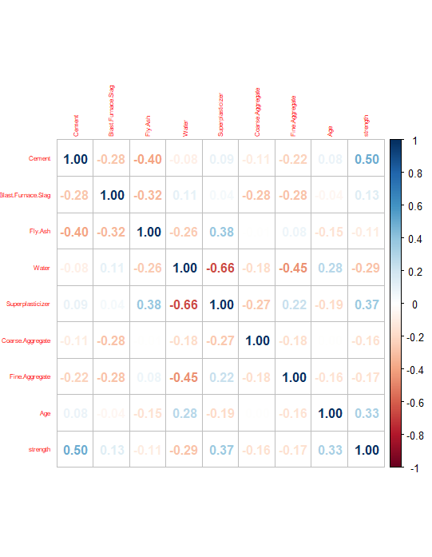
Correlation plot

Slide 7
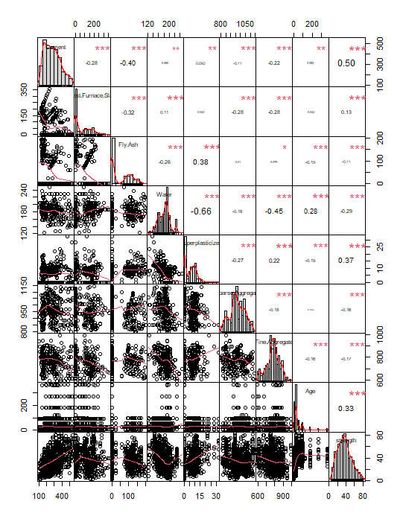
Correlation chart

Slide 8
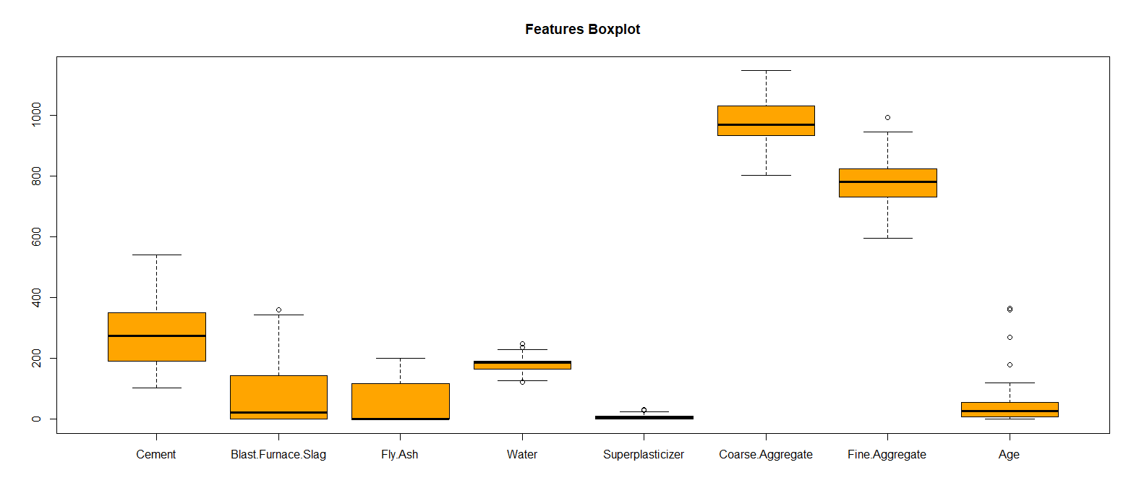
Box plot

Slide 9
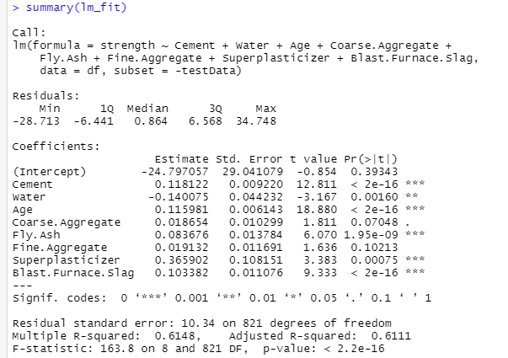
MODEL 1

Slide 10
Correlation between original and prediction values for model 1
#mean square error
mean((df[testData,]$strength-pred)^2)
113.6798
#correlation between original and prediction values
cor(df[testData,]$strength,predict(lm_fit,df[testData,]))
0.7815495
#root mean square error
rmse( df[testData,]$strength, predict(lm_fit,df[testData,]))
10.66207
#Mean absolute percentage error
MAPE( df[testData,]$strength, predict(lm_fit,df[testData,]))
0.2397936

Slide 11
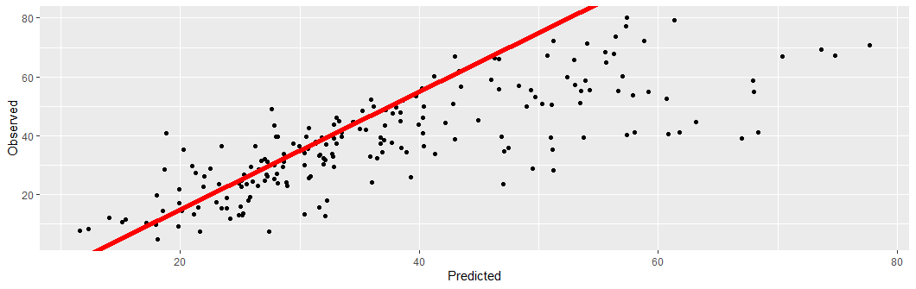

Slide 12
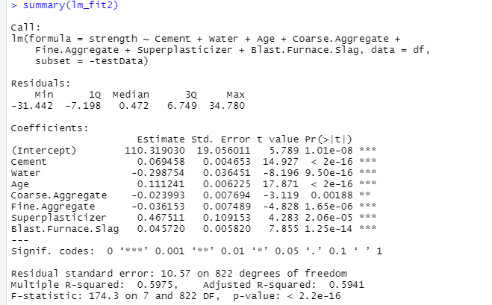
2nd model

Slide 13
Correlation between original and prediction value for model 2
#mean square error
mean((df[testData1,]$strength-pred1)^2)
120.6842
#correlation between original and prediction values
cor(df[testData1,]$strength,predict(lm_fit2,df[testData1,]))
0.7677824
#Root mean square error
rmse( df[testData1,]$strength, predict(lm_fit2,df[testData1,]))
10.98564
#mean absolute percentage error
MAPE( df[testData1,]$strength, predict(lm_fit2,df[testData1,]))
0.254022

Slide 14
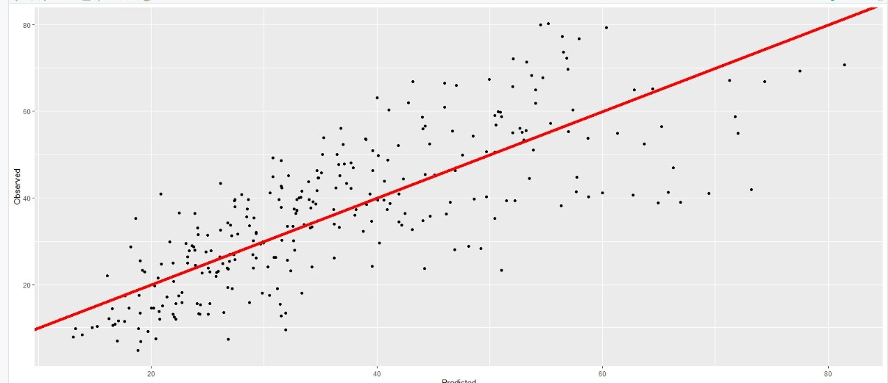

Slide 15
Conclusion
Model 1
Model 2
mean square error | 113.6798
correlation | 0.7815495
mean square error | 120.68
correlation | 0.7677824
adjusted R² | 0.6111
RMSE | 10.66
MAPE | 0.24
adjusted R² | 0.5941
RMSE | 10.986
MAPE | 0.254

Slide 16
THANK YOU

